Slide 1
Minimizing Service Loss and Data Theft with AAA and Dot1x

Slide 2

Upon completion of this section, you should be able to:
Explain why AAA is critical to network security.
Describe the characteristics of AAA.

Slide 3
What Is AAA?
  Authentication
  Authorization
  Accounting

Slide 4
Authentication
For Identifying users including:
login and password dialog
challenge and response
messaging support
depending on the security protocol you select, encryption

Slide 5
Authorization
For Remote access control including:
one-time authorization or authorization for each service
per-user account list and profile
user group support
support of IP, IPX, ARA, and Telnet

Slide 6
Accounting
For collecting and sending security server information used for billing, auditing and reporting
user identities
start and stop times
executed commands (such as PPP)
number of packets
number of bytes

Slide 7
AAA Model—Network Security Architecture
  Authentication
    Who are you?
    “I am user student and my password validateme proves it.”
  Authorization
    What can you do? What can you access?
    “User student can access host serverXYZ using Telnet.”
  Accounting
    What did you do? How long did you do it?
    How often did you do it?
    “User student accessed host serverXYZ using Telnet for
    15 minutes.”

Slide 8

Upon completion of this section, you should be able to:
Configure AAA authentication, using the CLI, to validate users against a local database.
Troubleshoot AAA authentication that validates users against a local database.

Slide 9
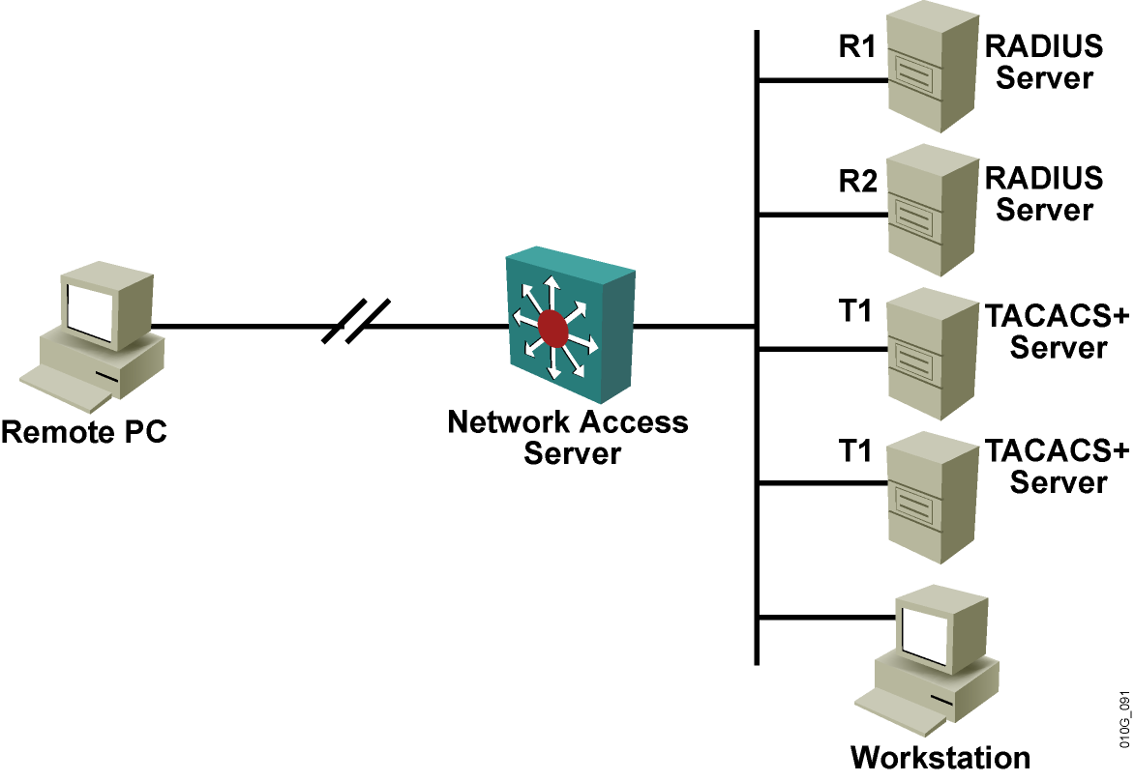
AAA Network Configuration
  Authentication
    Verifies a user identify
  Authorization
    Specifies the permitted tasks for the user
  Accounting
    Provides billing, auditing, and monitoring
Notes:
Lesson Aim
<Enter lesson aim here.>

Slide 10
Authentication Methods
Switch(config)#aaa authentication login {default |
list-name} method1 [method2...]
Creates a local authentication list
Cisco IOS AAA supports these authentication methods:
  Enable password
  Kerberos 5
  Kerberos 5-Telnet authentication
  Line password
  Local database
  Local database with case sensitivity
  No authentication
  RADIUS
  TACACS+
Notes:
Lesson Aim
<Enter lesson aim here.>

Slide 11


Implementing Authentication Using Local Services
Remote Client
Perimeter
Router
1
2
3
The client establishes a connection with the router.
The router prompts the user for a username and password.
The router authenticates the username and password in the local database. The user is authorized to access the network based on information in the local database.

Slide 12
Router Local Authentication Configuration Steps
The following are the general steps to configure a Cisco router to support local authentication:
  Add usernames and passwords to the local router database
  Enable AAA globally on the router
  Configure AAA parameters on the router
  Confirm and troubleshoot the AAA configuration

Slide 13
Local AAA Configuration Example
aaa new-model
aaa authentication login default local
enable secret 5 $1$x1EE$33AXd2VTVvhbWL0A37tQ3.
enable password 7 15141905172924
!
username admin1 password 7 14161606050A7B7974786B
username admin2 secret 5 $1$ErWl$b5rDNK7Y5RHkxX/Ks7Hr00
!

Slide 14


Implementing Authentication Using External Servers
Cisco Secure ACS for Windows Server
Perimeter
Router
1
3
2
Cisco Secure
ACS
Solution Engine
4
Remote Client
Cisco Secure
ACS Express
The client establishes a connection with the router.
The router prompts the user for a username and password.
The router passes the username and password to the Cisco Secure ACS (server or engine).
The Cisco Secure ACS authenticates the user. The user is authorized to access the router (administrative access) or the network based on information found in the Cisco Secure ACS database.

Slide 15



TACACS+ and RADIUS AAA Protocols
Security Server
  TACACS+ and RADIUS are used to communicate between the AAA security servers and authenticating devices.
  Cisco Secure ACS supports both TACACS+ and RADIUS:
    TACACS+ remains more secure than RADIUS.
    RADIUS has a robust application programming interface and strong accounting.
Cisco Secure ACS
TACACS+
RADIUS
Switch
Firewall
Router
NAS

Slide 16
TACACS+ Overview
  Is not compatible with its predecessors TACACS
  and XTACACS
  Separates authentication and authorization
  Supports a large number of features
  Encrypts all communication
  Utilizes TCP port 49

Slide 17
RADIUS Overview
  RADIUS was developed by Livingston Enterprises.
  RADIUS proxy servers are used for scalability.
  RADIUS combines authentication and authorization as one process.
  DIAMETER is the planned replacement.
  Technologies that use RADIUS include
    Remote access (i.e., dial-up and DSL)
    802.1X
    SIP

Slide 18






TACACS+/RADIUS Comparison
 | TACACS+ | RADIUS
Functionality | Separates AAA | Combines authentication and authorization
Standard | Mostly Cisco supported | Open/RFC
Transport Protocol | TCP | UDP
CHAP | Bidirectional | Unidirectional
Protocol Support | Multiprotocol support | No ARA, no NetBEUI
Confidentiality | Entire packet encrypted | Password encrypted
Customization | Provides authorization of router commands on a per-user or per-group basis. | Has no option to authorize router commands on a per-user or per-group basis.
Accounting | Limited | Extensive
Dial
TACACS+ Client
RADIUS Client
Campus
TACACS+ Server
RADIUS Server

Slide 19
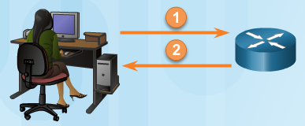
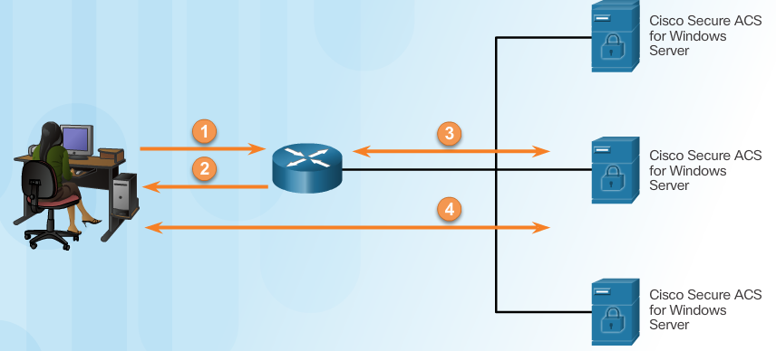
Comparing Local AAA and Server-Based AAA Implementations
Local authentication:
User establishes a connection with the router.
Router prompts the user for a username and password, authentication the user using a local database.
Server-based authentication:
User establishes a connection with the router.
Router prompts the user for a username and password.
Router passes the username and password to the Cisco Secure ACS (server or engine)
The Cisco Secure ACS authenticates the user.
Notes:
3.3.1.1 Comparing Local AAA and Server-Based AAA Implementations

Slide 20
Steps for Configuring Server-Based AAA Authentication with CLI
Enable AAA.
Specify the IP address of the ACS server.
Configure the secret key.
Configure authentication to use either the RADIUS or TACACS+ server.
Notes:
3.4.1.1 Steps for Configuring Server-Based AAA Authentication with CLI

Slide 21
AAA Configuration for TACACS+ Example
aaa new-model
!
aaa authentication login TACACS_SERVER tacacs+ local
aaa authorization exec tacacs+
!
!
tacacs-server host 10.0.1.11
tacacs-server key ciscosecure
!
line vty 0 4
login authentication TACACS_SERVER

Slide 22
debug tacacs
router#debug tacacs
14:00:09: TAC+: Opening TCP/IP connection to 10.1.1.4/49
14:00:09: TAC+: Sending TCP/IP packet number 383258052-1 to 10.1.1.4/49 (AUTHEN/START)
14:00:09: TAC+: Receiving TCP/IP packet number 383258052-2 from 10.1.1.4/49
14:00:09: TAC+ (383258052): received authen response status = GETUSER
14:00:10: TAC+: send AUTHEN/CONT packet
14:00:10: TAC+: Sending TCP/IP packet number 383258052-3 to 10.1.1.4/49 (AUTHEN/CONT)
14:00:10: TAC+: Receiving TCP/IP packet number 383258052-4 from 10.1.1.4/49
14:00:10: TAC+ (383258052): received authen response status = GETPASS
14:00:14: TAC+: send AUTHEN/CONT packet
14:00:14: TAC+: Sending TCP/IP packet number 383258052-5 to 10.1.1.4/49 (AUTHEN/CONT)
14:00:14: TAC+: Receiving TCP/IP packet number 383258052-6 from 10.1.1.4/49
14:00:14: TAC+ (383258052): received authen response status = PASS
14:00:14: TAC+: Closing TCP/IP connection to 10.1.1.4/49

Slide 23
Setting Multiple Privilege Levels
router(config)#
privilege mode {level level command | reset command}
  Level 0 is predefined for user-level access privileges.
  Levels 1 to 14 may be customized for user-level privileges.
  Level 15 is predefined for enable mode (enable command).
Boston(config)#privilege exec level 2 ping
Boston(config)#enable secret level 2 Patriot

Slide 24



Slide 25
IEEE 802.1x
  Standard set by the IEEE 802.1 working group
  A framework designed to address and provide port-based access control using authentication
  Primarily an encapsulation definition for EAP over IEEE 802 media (EAPOL is the key protocol.)
  Layer 2 protocol for transporting authentication messages
  (EAP) between supplicant (user/PC) and authenticator (switch or access point)
  Assumes a secure connection
  Actual enforcement is via MAC-based filtering and port-state monitoring

Slide 26


802.1x Components
Supplicant
Authenticator
Authentication Server
EAPOL
RADIUS

Slide 27
How 802.1x Works
End User
(Client)
Cisco Catalyst
2950 Series Switch
Authentication Server
(Cisco Secure ACS)
EAPOL
RADIUS
The actual authentication conversation occurs between the client and the authentication server using EAP. The authenticator is aware of this activity, but it is just an intermediary.

Slide 28










Concepts of 802.1x in Action
Unauthorized External
Wireless User
Identity-Based Authentication
X
No Access
Invalid/No Credentials
√
Valid Credentials
Corporate
Network
Corporate Resources
Authorized User
Notes:
With 8021x, you can set up two different DHCP pools, you can assign address in 10 address to devices that can authenticate properly, and for a device that doesn’t offer the right credentials, you can assign them to a 192 address dynamically and use that IP address to determine who gets in the tunnel, and who does not; you have the ability to differentiate and allocate multiple DHCP pools
When the teleworker starts up or connects the PC on the home LAN, the PC usually first requests its network identity (IP address) and other needed information from a DHCP server; for PCs enabled for 802.1X, the first request is an Extensible Authentication Protocol over LAN (EAPOL) request; when the VPN device (such as a Cisco 83x router) sees this request, it challenges the PC, which responds with the appropriate credentials (userid and password for example); the router checks with the AAA server across the VPN to authenticate the user’s credentials via RADIUS; if the teleworker logs in successfully, the PC is provided a network identity and other information via DHCP which allow access to the enterprise via the VPN; if a PC is not 802.1X capable, or the user does not log in successfully, the
PC will be provided a network identity that only allows Internet access
The following are VPN access control using 802.1X authentication feature advantages:
User is prompted upon PC start up or plug-in to the LAN; web access to a protected site to initiate challenge is not required (as in Authentication Proxy)
The IP phone can be automatically allowed through the VPN; CDP is used for IP phone discovery
A separate address range for spouse-and-child PCs allows for standardized addressing and access control, and a smaller enterprise addressable subnet for each teleworker home
The teleworker can still communicate with non-enterprise PCs, print servers, and the like, if permitted—allowing for sharing between all home workstations
Multiple authentication types are supported, including two-way authentication and the use of certificates, as permitted in the 802.1X standard; EAP-MD5, PEAP, and EAP-TLS are among the supported authentication methods
PCs with static IP addresses in the enterprise addressable subnet cannot access the VPN until 802.1X authentication occurs; this reduces rogue access
Any wireless PC (teleworker, spouse, child, or rogue) by default cannot gain enterprise access; this reduces rogue access

Slide 29

802.1x and VLAN Assignment
A = Attacker
I do not know A;
I do know B, and B gets VLAN 10.
Port unauthorized
Cisco Secure ACS/RADIUS
Identity with VLAN Assignment
B = Legitimate User

Slide 30
802.1x and the Guest VLAN
Remediation Server
A = Attacker
Non-IEEE
802.1x -compliant
(no supplicant)
I do not know A,
I do know B, and B gets VLAN 10.
Port is put into guest VLAN.
Identity with
Guest VLAN
Cisco Secure ACS/RADIUS
B = Legitimate User

Slide 31
802.1x and the Restricted VLAN
Remediation Server
A = Attacker
I do not know A,
I do know B, and B gets VLAN 10.
Is IEEE 802.1x-compliant, but fails authentication
Port is put into protected VLAN.
Identity with
Protected VLAN
Cisco Secure ACS/RADIUS
B = Legitimate User

Slide 32
Configuring 802.1x
Switch(config)#aaa new-model
Enables AAA
Switch(config)#aaa authentication dot1x {default} method1
[method2…]
Creates an 802.1x port-based authentication method list
Switch(config)#dot1x system-auth-control
Globally enables 802.1x port-based authentication
Switch(config)#interface type slot/port
Enters interface configuration mode:
Switch(config-if)#switchport mode access
Switch(config-if)# authentication port-control auto
Switch(config-if)# dot1x pae authenticator
Enables 802.1x port-based authentication on theinterface
Notes:
Lesson Aim
<Enter lesson aim here.>

Slide 33
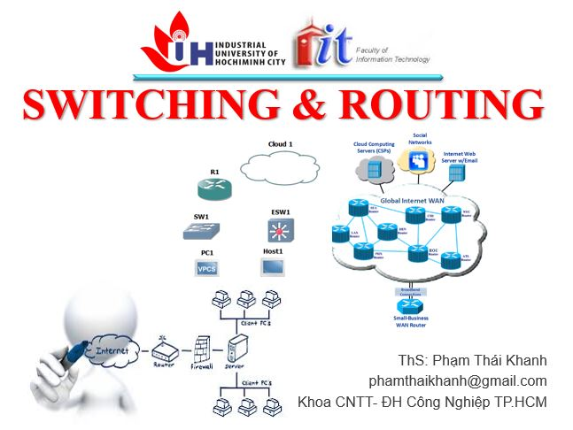


phamthaikhanh@gmail.com
This Photo by Unknown Author is licensed under CC BY-NC

